Slide 1
Introduction To Data Mining
Aaron Bohlmann

Slide 2
What is a CSV file?
PharmD
Post Doctoral Fellow
Studying to get a master’s degree in clinical informatics

Slide 3
What is a CSV file?
CSV is a comma-separated values file
Text in rows separated by commas
Commas show column divisions
Represents a table with text

Slide 4
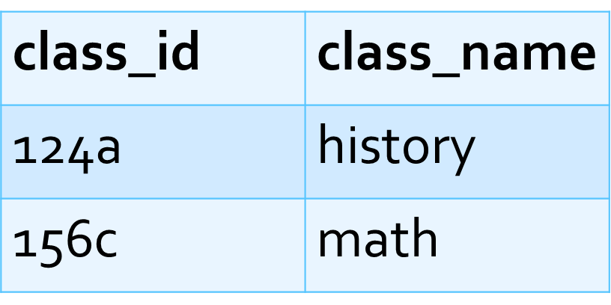
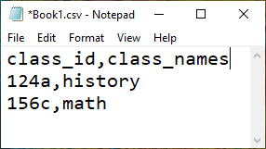
On the left side is a table and on the right is a CSV file of the same info

Slide 5
How will we use CSV files?
Upload (read) CSV files into R
R is open source software for data analytics
Used to manipulate the uploaded data
You will not have to download the software
Jupyter notebooks
Run code in your internet browser

Slide 6
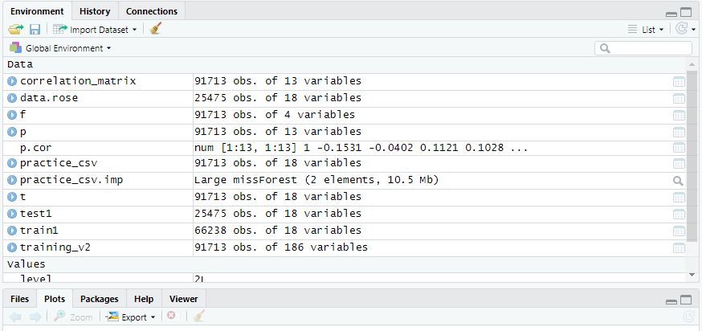
Uploading a CSV file (Informational Only)

Slide 7
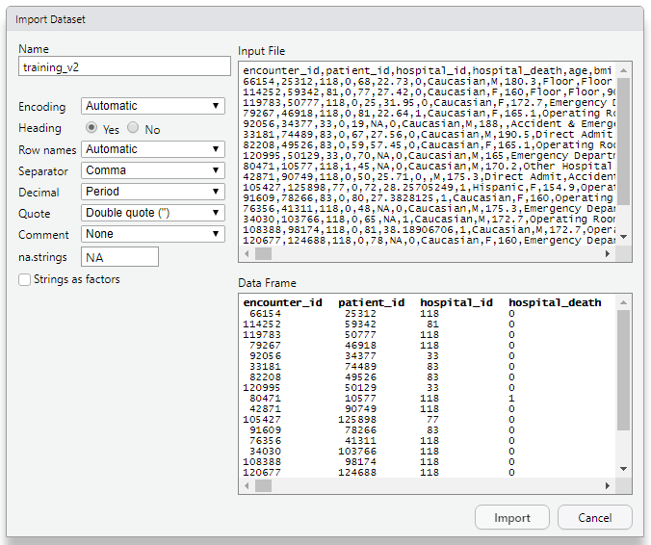
Uploading a CSV file (Informational Only)

Slide 8
The CSV is uploaded now what?
Clean the data
Null values
Empty cells in your table
Cannot do math with empty cells
Implausible values

Slide 9
Data cleaning
Null values
Delete rows or columns
Used when there is a lot of missing data
Rule of thumb for deleting a column, if 70% or more of the data is missing delete it
Losing data can impact model performance
Replace the null cells with column measure of center
Less data loss (more accurate model predictions)
Basic approach, more advanced methods work better
Mean (only for numeric data)
If data is evenly distributed
Median or Mode
If the data is skewed
Mode can be used for categorical data since it is simply a count of the most frequent entry in a specific column

Slide 10
Data cleaning
Null values
Replace the missing values with predicted values
Missing variable may be predictable based on the information present
Prediction is done using a machine learning algorithm
Random forest imputation algorithm
Can predict categorical or numeric data
Create a new category for a null cell
Only for categorical variables
New category is basically unknown

Slide 11
Implausible values
Values that do not make sense
Negative age or age longer than a human life span
Replace implausible values
Use methods described for replacing null values
Mean, mode, median
Replacement with predicted value
Machine learning algorithm

Slide 12
Quiz
In a CSV file what separates each column? a. , b. . c. / d. %% When a column has more missing values than actual values what is the best course of action? a. Replace the missing values with the column mean b. Replace the missing values with the column median c. Delete the column from the dataset d. Replace the missing values with zero

